Slide 1

Information and Communication Technologies (TIC) and Related Tools
A Comprehensive Overview of Google Services, Microsoft Tools, Git, and GitHub
Benbouhadi mohammed sami
section:SIGL

Slide 2

Introduction
Information and Communication Technologies (TIC)
Google Services
Microsoft Tools
Git and GitHub
Conclusion

Slide 3

Introduction
Overview of the Importance of TIC:
TIC plays a crucial role in modern society, shaping how information is processed, communicated, and accessed.
Purpose of the Report:
This report aims to provide a comprehensive understanding of Information and Communication Technologies (TIC) and explore key tools such as Google Services, Microsoft Tools, Git, and GitHub.
Overview of Covered Technologies:
Briefly introduce the four main technologies to be covered: Google Services, Microsoft Tools, Git, and GitHub.

Slide 4

Google services
Overview of Google as a Technology Company:
Briefly introduce Google and its role as a major player in the technology industry.
Key Google Services:
Provide an in-depth look at essential Google Services such as Search, Gmail, Google Drive, and productivity tools like Docs, Sheets, and Slides.
Visuals and Tables:
Include screenshots, charts, and tables to illustrate key features, use cases, and user interfaces.

Slide 5
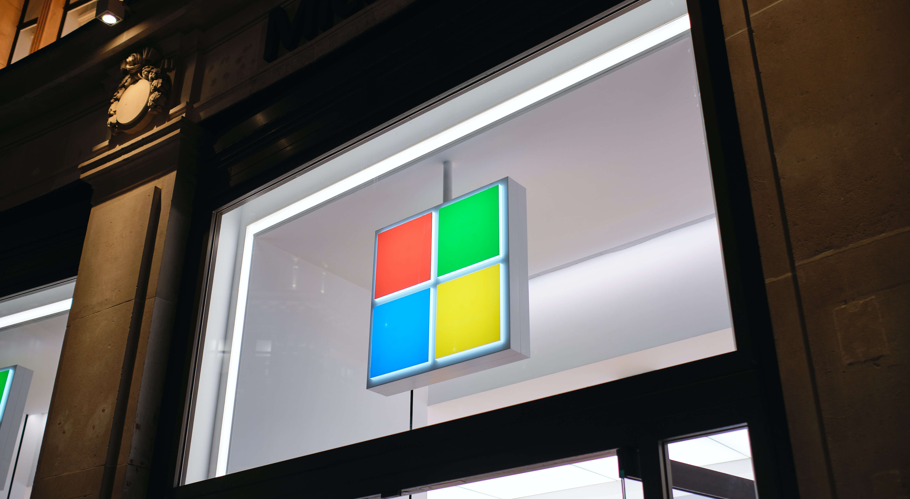
Microsoft Tools
Introduction to Microsoft:
Provide an overview of Microsoft, emphasizing its influence in both personal and professional computing.
Key Microsoft Tools:
Explore prominent Microsoft Tools including the Office Suite (Word, Excel, PowerPoint), Microsoft Teams, and Azure DevOps.
Visuals and Tables:
Utilize visuals to showcase interfaces, collaboration features, and integration capabilities.

Slide 6

Git and Github
Explanation of Version Control:
Define version control and its importance in managing software development projects.
Introduction to GitHub:
Explain GitHub as a collaborative platform for software development, emphasizing its role in version control and project management.
Key Features:
Highlight essential features of Git and GitHub, such as branching, merging, pull requests, and issue tracking.
Visual Representation:
Include a visual representation of a Git workflow to help the audience understand the collaborative development process.

Slide 7
Conclusion
Summary of Key Points:
Summarize the key points covered in the report, emphasizing the significance of TIC and the role of the discussed technologies.
Importance in the Digital Era:
Discuss how these technologies contribute to digital transformation and innovation in various fields.
Opportunities and Challenges:
Touch upon the opportunities these technologies present and the challenges that may arise in their implementation.

